Slide 1

Churn for Bank Customers
Muthukumar Kadhirvel
APPLIED DATA SCIENCE (DSC 680)

Slide 2
BUSINESS PROBLEM
Retention of customers – Vital Role in keeping banks profitable
Increasing customer lifetime value
Churn – Degree of customer inactivity over a given time
Predicting customer churn in absence of feedback
Acquiring new customers costly
If we can predict customer churn can develop loyalty programs
Build predictive model whether customer would leave the bank

Slide 3
Data Processing - EDA
Churn dataset from Kaggle ​
Customer data from France/Spain/Germany
10000 rows and 14 columns
Feature variables – All variables except target are a mixture of numeric and categorical variables
Target variable – Exited variable of 0 (Not left the bank) or 1 (Left the bank)
Drop unneeded variables – RowNumber/CustomerID/Surname
No missing or NULL values
Categorical Variables – Georgraphy/Gender – Create dummy variables

Slide 4
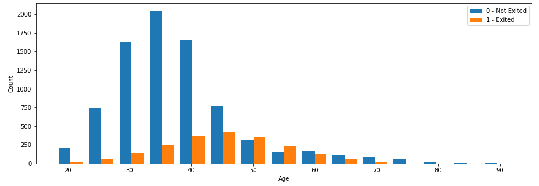
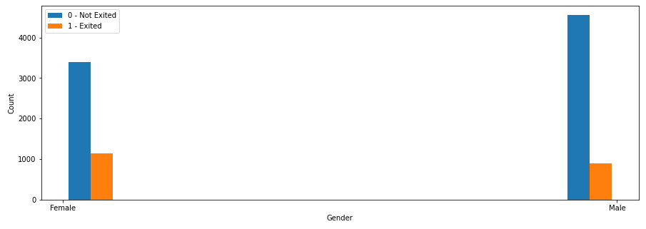
Visualization
Age - Customers with age between 50 and 60 exited the bank more than other age classes
Gender – Female customers exited the bank more than male customers

Slide 5
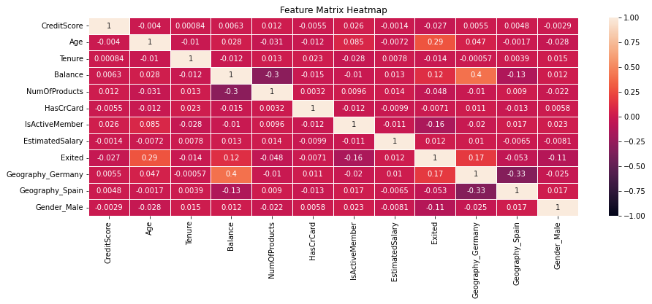
Visualization (CONT.)
Point-biserial Correlation – Mixture of Binary & Continuous Variables against Target
No variables have good correlation with target variable
No variables have good correlation with other variables as well

Slide 6
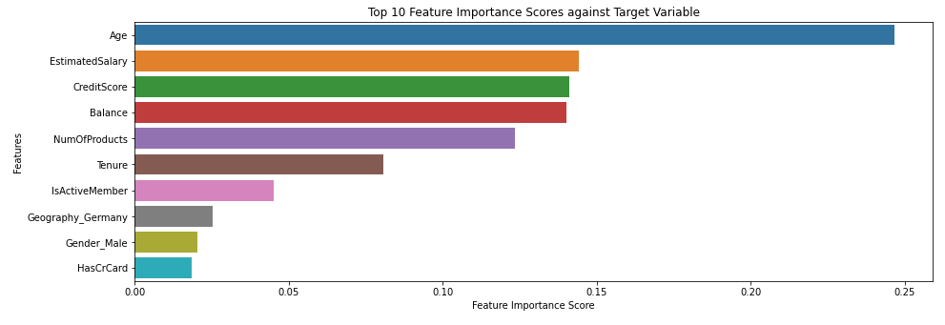
Visualization (CONT.)
Top 10 Feature Importance Scores against Target Variable
Age has the most feature importance

Slide 7
MODELS AND METRICS
Binary classification problem
Models Used - ​Logistic Regression / KNN / Support Vector Machine / Random Forest Classifier
Split into training dataset and test dataset in the ratio of 80% to 20%
Target is whether customer left the bank or not
Features series has the rest of the columns
Accuracy is used as the evaluation metric
Confusion matrix ensures the number of false positive and false negatives are less

Slide 8
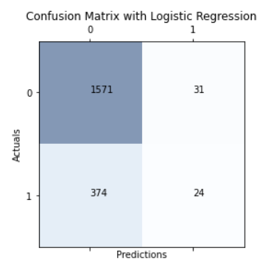
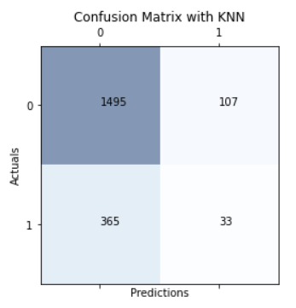
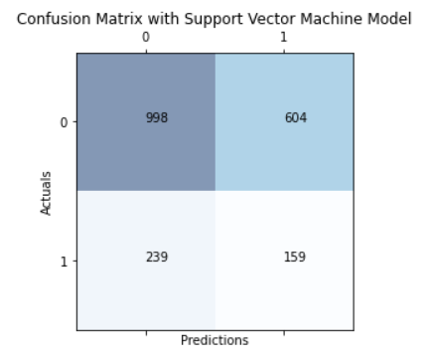
MODEL EVALUATION
Logistic Regression/KNN/Support Vector Machine - Good accuracy but bad at predicting Target variable
Support Vector Machine – Has more False Positives than other models

Slide 9
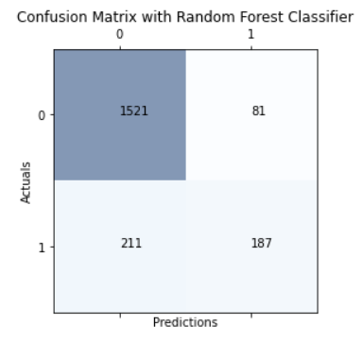
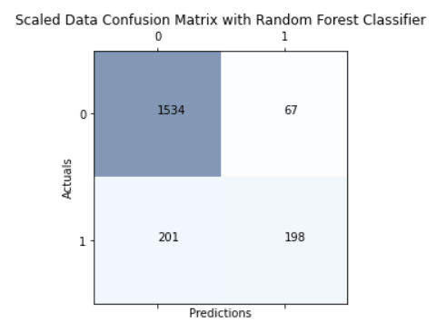
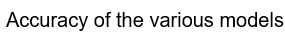
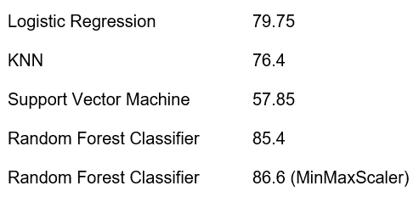
MODEL EVALUATION (CONT.)
Random Forest Classifier – Better Accuracy and Confusion Matrix
MinMaxScaler was performed on the dataset and accuracy and Confusion Matrix yielded better results

Slide 10
CONCLUSION
Random Forest Classifier model with MinMaxScaler yielded the best results and will be used to go ahead with implementation
Limitation - Other impacting factors like Accessibility/Digitization etc. are unavailable
Continue to input more sample data that becomes available to retrain our model
Recurring mechanism to keep the model in line with the current data
Can use this model to predict binary classification problems in customer churn of other institutions
Loyalty programs can be offered to retain predicted customers

Slide 11
REFERENCES
Sethuraman, S. (2022, November 2). Why customers leave & what can banks do? Tiger Analytics. Retrieved April 16, 2023, from https://www.tigeranalytics.com/blog/addressing-customer-churn-in-banking/
Krook, S. (2022, March 7). What is customer churn prediction and why is it important? Avaus. Retrieved April 16, 2023, from https://www.avaus.com/blog/predicting-customer-churn/
Lappeman, J., Franco, M., Warner, V., & Sierra-Rubia, L. (2022, May 26). What social media sentiment tells us about why customers churn. Journal of Consumer Marketing. Retrieved April 30, 2023, from https://www.emerald.com/insight/content/doi/10.1108/JCM-12-2019-3540/full/html

Slide 12
THANK YOU
Muthukumar Kadhirvel
402-301-2069
mkadhirvel@my365.bellevue.edu

